Slide 1

TEMPTREK PRODUCT FRAMEWORK
Notes:
Welcome to this comprehensive presentation on the TempTrek Product Framework and Marketing Strategy. Today, we will dive deep into how TempTrek, an innovative high-tech travel coffee mug, stands out in the market and explore a detailed strategy for reaching and engaging our target audience. Let's begin!

Slide 2


Comprehensive Overview and Marketing Strategy
TempTrek - High-Tech Coffee Mug
Introduction
Table of Content
Product Overview
Business Model Canvas
Value Matrix
Target Audience
Marketing Strategies
Additional Marketing Channels
Key Metrics to Track
Setting Up Analytics
Conclusion
‘TempTrek - Beyond The Perfect Sip’
Notes:
The TempTrek Product Framework revolutionizes coffee mug temperature management by introducing eco-friendly and cutting-edge mug innovation that keeps coffee at the perfect temperature all day. Designed for on-the-go individuals.

Slide 3
PRODUCT OVERVIEW
KEY FEATURES
TempTrek: High-Tech Travel Coffee Mug
Self-heating technology
Maintains perfect temperature for 8 hours
Egonomic design
Easy-to read temperature display
Long battery Life
USB rechargeability
Leak-proof
Easy to clean
Durable
Notes:
TempTrek is designed for those who prioritize both convenience and style in their daily routines. Its innovative self-heating technology ensures that your coffee stays at the perfect temperature for up to 8 hours. Whether you’re on the go or at your desk, the ergonomic design and easy-to-read temperature display make it user-friendly. Plus, with its long battery life, USB rechargeability, and leak-proof design, TempTrek is the ultimate companion for coffee lovers. Durability and ease of cleaning further enhance its appeal, making it an everyday essential for busy professionals, adventurers, and more.

Slide 4
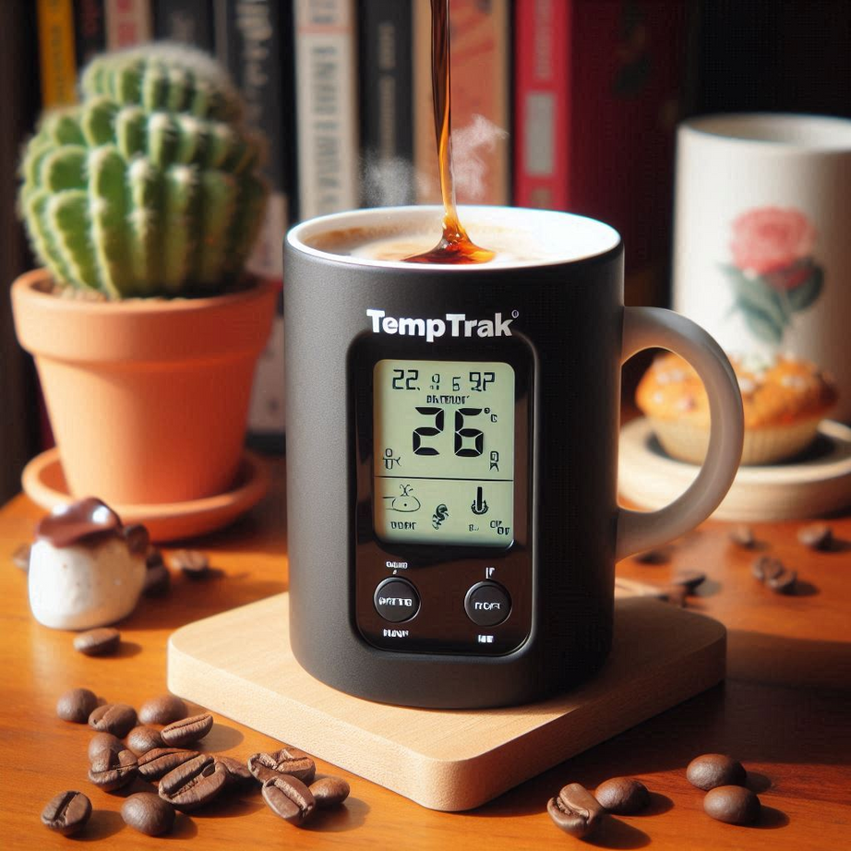
BUSINESS MODEL CANVAS
Key Partners: Manufacturers, suppliers, distributors, marketing agencies, technology partners
Key Activities: Product development, marketing and sales, customer service, supply chain management, sustainability initiatives
Key Resources: Technology, human resources, brand, intellectual property
Value Propositions: Convenience, sustainability, durability, style, luxury
Customer Relationships: Personalized support, community engagement, loyalty programs, feedback mechanisms
Notes:
The TempTrek business model is built around key partnerships, strategic activities, and a resource-driven approach. Collaborations with manufacturers and suppliers ensure the seamless development and distribution of TempTrek products. Core activities like product development, marketing, and supply chain management are designed to keep TempTrek at the forefront of the market. Our value propositions focus on luxury, style, and convenience, appealing to a diverse customer base. By maintaining strong customer relationships through loyalty programs and personalized support, we aim to build a lasting brand presence across multiple channels, from online stores to retail partnerships.

Slide 5
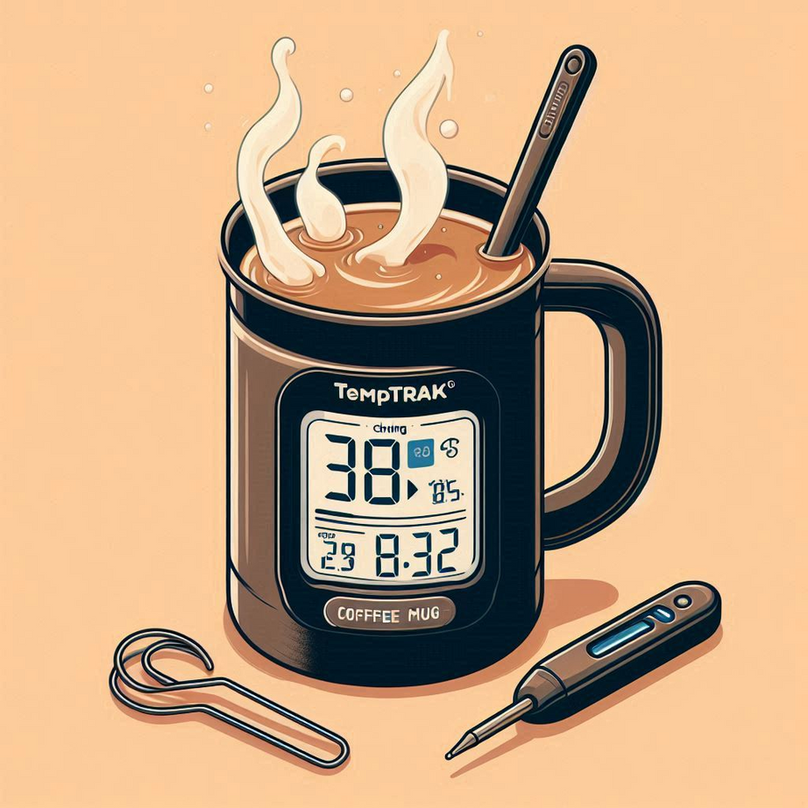
BUSINESS MODEL CANVAS cont.
Key Partners: Manufacturers, suppliers, distributors, marketing agencies, technology partners
Channels: Online store, retail partners, social media, email marketing, events and trade shows
Customer Segments: Busy professionals, adventure enthusiasts, health-conscious parents, fashion-forward individuals, luxury seekers, eco-conscious consumers
Cost Structure: Production costs, marketing expenses, R&D, distribution costs, customer service
Revenue Streams: Direct sales, subscription services, partnerships, premium editions
Notes:
The TempTrek business model is built around key partnerships, strategic activities, and a resource-driven approach. Collaborations with manufacturers and suppliers ensure the seamless development and distribution of TempTrek products. Core activities like product development, marketing, and supply chain management are designed to keep TempTrek at the forefront of the market. Our value propositions focus on luxury, style, and convenience, appealing to a diverse customer base. By maintaining strong customer relationships through loyalty programs and personalized support, we aim to build a lasting brand presence across multiple channels, from online stores to retail partnerships.

Slide 6
VALUE MATRIX
Prioritizing features based on importance to different customer segments
Self-heating technology | Maintains temperature 8 hrs | Ergonomic design
Easy-to-read display | Long battery life | USB rechargeability
Leak-proof | Easy to clean | Durable
Notes:
The value matrix provides a strategic overview of how different features of TempTrek are prioritized across various customer segments. For busy professionals and adventurers, features like self-heating technology and long battery life are crucial. Meanwhile, fashion-forward individuals and luxury seekers place a premium on the ergonomic design and style. The matrix helps us align our product offerings with what truly matters to each segment, ensuring that TempTrek meets the specific needs and preferences of diverse groups.

Slide 7
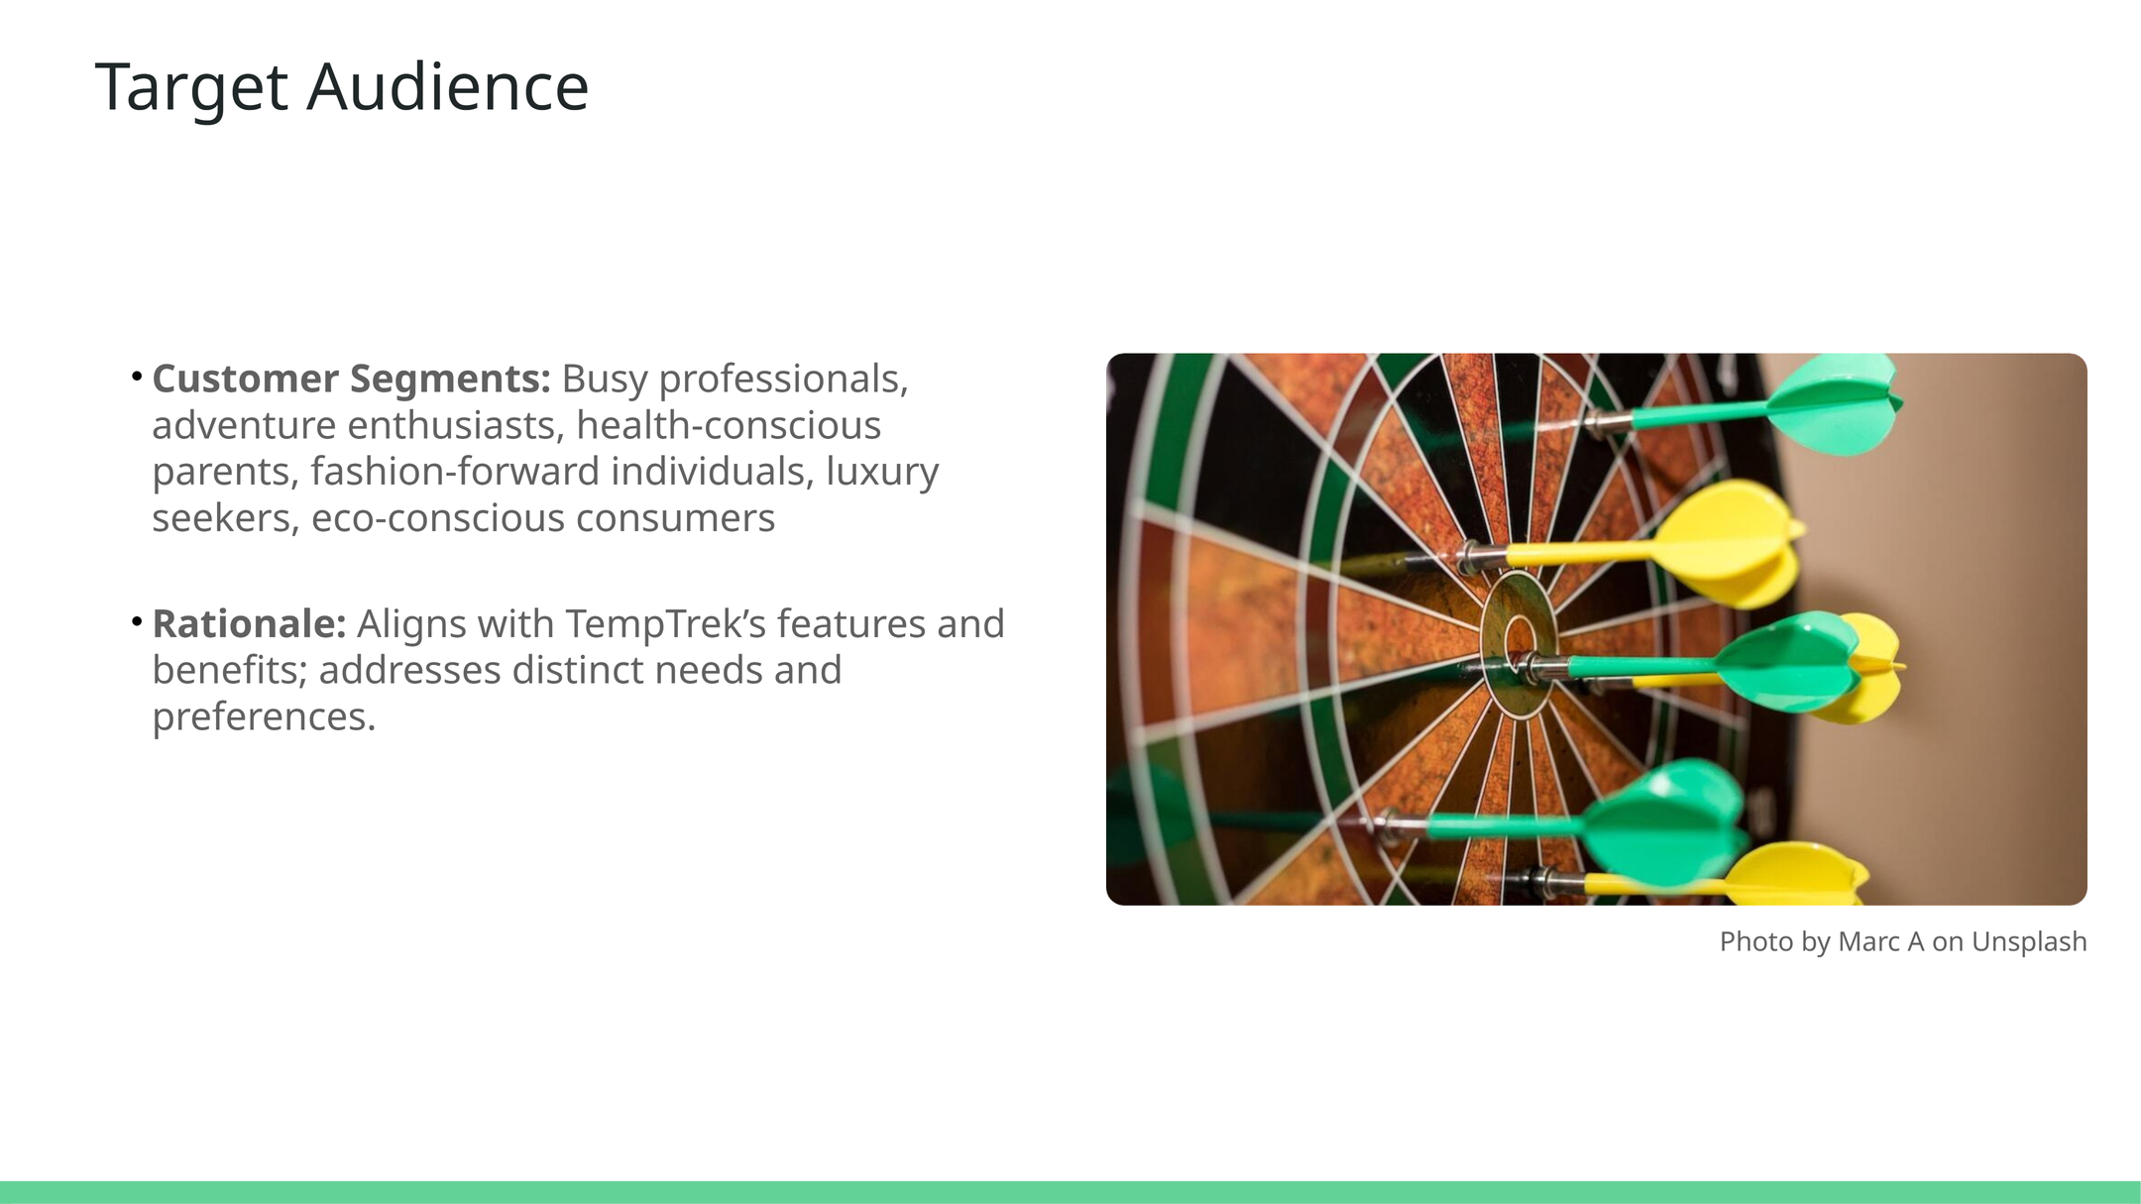
TARGET AUDIENCE
Segments:
Busy Professionals
Adventure Enthusiasts
Health-Conscious Parents
Fashion-Forward Individuals
Luxury Seekers
Eco-Conscious Consumers
Rationale:
Aligns with TempTrek’s features and benefits
Addresses distinct needs and preferences
Notes:
TempTrek’s target audience is diverse, ranging from busy professionals who need convenience to eco-conscious consumers who prioritize sustainability. The product’s unique features—like self-heating technology, ergonomic design, and stylish appearance—cater to a wide range of preferences. Adventure enthusiasts, for example, value durability and long battery life, while fashion-forward individuals appreciate the sleek design. Each segment is carefully considered in our marketing strategy to ensure TempTrek resonates with their specific needs.

Slide 8




MARKETING STRATEGIES
BUSY PROFESSIONALS
ADVENTURE ENTHUSIASTS:
HEALTH-CONSCIOUS PARENTS:
LinkedIn
Email Marketing
Twitter
Content Marketing
Instagram
YouTube
Facebook
Influencer Marketing
Facebook
Pinterest
Email Marketing
Parenting Blogs
Notes:
Our marketing strategy is tailored to effectively reach each customer segment by leveraging the channels they are most active on. For busy professionals, LinkedIn and content marketing play crucial roles, while adventure enthusiasts are engaged via Instagram and influencer campaigns. Health-conscious parents are targeted through platforms like Pinterest and specialized blogs. Fashion-forward individuals and luxury seekers are attracted through visual platforms like TikTok and Instagram. Meanwhile, eco-conscious consumers resonate with sustainable messaging through relevant blogs and community engagement. This segmented approach ensures TempTrek speaks directly to the diverse audience it serves.

Slide 9



MARKETING STRATEGIES
CONT.
FASHION-FORWARD INDIVIDUALS
LUXURY SEEKERS
EC0-CONSCIOUS CONSUMERS
Instagram
Email Marketing
Luxury Magazines
Exclusive Events
Facebook
Instagram
Email Marketing
Eco-Friendly Blogs
Instagram
TikTok
Influencer Marketing
Email Marketing
Notes:
Our marketing strategy is tailored to effectively reach each customer segment by leveraging the channels they are most active on. For busy professionals, LinkedIn and content marketing play crucial roles, while adventure enthusiasts are engaged via Instagram and influencer campaigns. Health-conscious parents are targeted through platforms like Pinterest and specialized blogs. Fashion-forward individuals and luxury seekers are attracted through visual platforms like TikTok and Instagram. Meanwhile, eco-conscious consumers resonate with sustainable messaging through relevant blogs and community engagement. This segmented approach ensures TempTrek speaks directly to the diverse audience it serves.

Slide 10
Influencer Marketing
Experiential Marketing
Content Marketing
Social Media Contests
Community Partnerships
Cause Marketing
Guerrilla Marketing
Referral Programs
User-Generated Content Campaigns
Personalized Marketing
ADDITIONAL MARKETING CHANNELS
‘TempTrek - Beyond The Perfect Sip’
Notes:
In addition to traditional marketing channels, TempTrek will leverage creative and community-driven strategies. Influencer marketing and experiential events help build brand awareness in authentic ways. Content marketing will provide educational resources that align with our product values. Social media contests and guerrilla marketing generate buzz while keeping costs low. By partnering with local communities and supporting eco-friendly initiatives, TempTrek aligns with socially conscious values. These additional channels allow us to diversify our approach and engage customers on multiple levels.

Slide 11
Social Media: | Impressions, Engagement Rate, CTR, Conversion Rate
Email Marketing | Open Rate, CTR, Conversion RatBounce Rate, Unsubscribe Rate
Content Marketing | Website Traffic, Time on Page, Bounce Rate, Social Shares, Backlinks
Influencer Marketing: | Engagement Rate, Reach, Impressions, Referral Traffic, Conversion Rate
Paid Advertising | CTR, Conversion Rate, ROI
Referral Programs: | Referral Traffic, Conversion Rate, Referral Rate, CLV, CPA
Experiential Marketing: | Event Attendance, Engagement Rate, Lead Generation, Social Media Mentions, Post-Event Surveys, Conversion Rate
KEY METRICS TO TRACK
‘TempTrek - Beyond The Perfect Sip’
Notes:
In addition to traditional marketing channels, TempTrek will leverage creative and community-driven strategies. Influencer marketing and experiential events help build brand awareness in authentic ways. Content marketing will provide educational resources that align with our product values. Social media contests and guerrilla marketing generate buzz while keeping costs low. By partnering with local communities and supporting eco-friendly initiatives, TempTrek aligns with socially conscious values. These additional channels allow us to diversify our approach and engage customers on multiple levels.

Slide 12
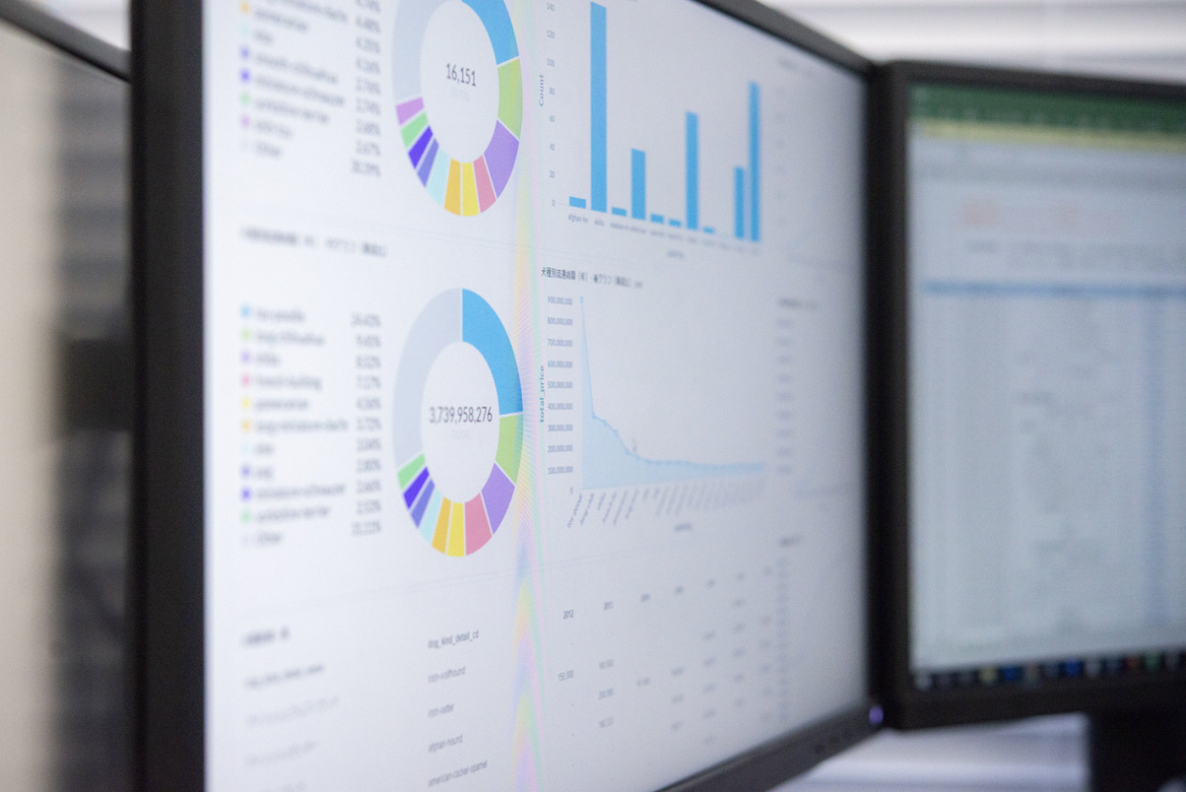
Identify Channels: List all marketing channels
Implement Trackers: Use specific tools for each channel
Integrate Tools: Connect analytics tools with other platforms
Set Up Goals: Define goals and set up conversion tracking
Monitor Data: Regularly monitor dashboards
Optimize: Use insights to optimize campaigns
SETTING UP ANALYTICS
‘TempTrek - Beyond The Perfect Sip’
Notes:
In addition to traditional marketing channels, TempTrek will leverage creative and community-driven strategies. Influencer marketing and experiential events help build brand awareness in authentic ways. Content marketing will provide educational resources that align with our product values. Social media contests and guerrilla marketing generate buzz while keeping costs low. By partnering with local communities and supporting eco-friendly initiatives, TempTrek aligns with socially conscious values. These additional channels allow us to diversify our approach and engage customers on multiple levels.

Slide 13
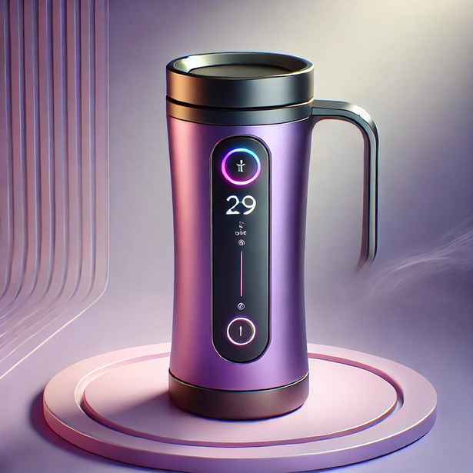
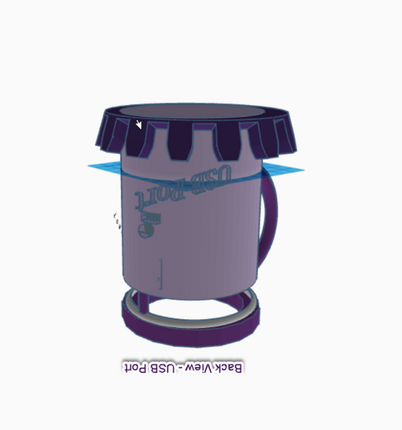
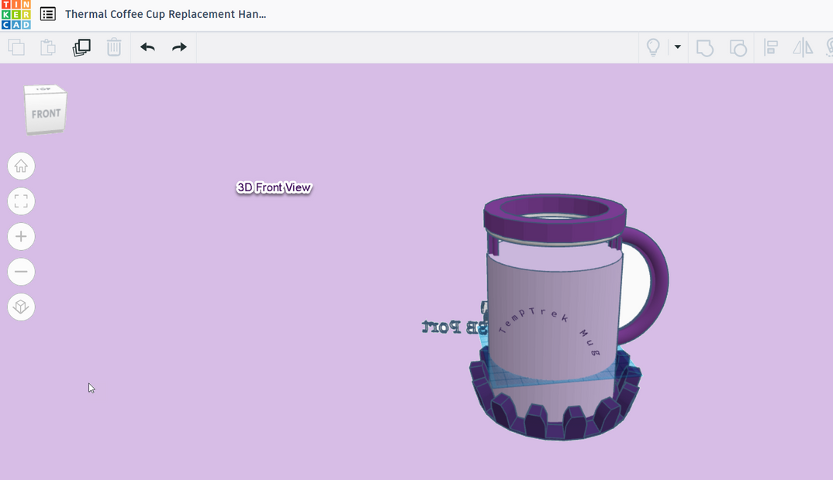
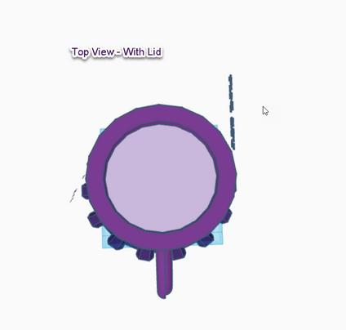
INTRODUCING TEMPTREK COFFEE MUG IN 3D
BACK VIEW 3D
BOTTOM VIEW - SELF HEATING PLATE 3D
Notes:
Setting up analytics is crucial for ensuring that marketing campaigns for TempTrek are effective and data-driven. First, all channels need to be identified and mapped out, with tools like Google Analytics and social media insights used for tracking. These tools should be integrated to allow for seamless data collection across platforms. Conversion goals must be clearly defined and monitored regularly through dashboards. Continuous monitoring and optimization are key to improving campaign performance based on real-time insights, enabling the marketing team to make informed decisions and adjust strategies for maximum impact.

Slide 14

Team TempTrek!!!
CONCLUSION
NEXT STEPS:
IMPLEMENT STRATEGIES,
TRACK METRICS,
OPTIMIZE CAMPAIGNS

Slide 15

Q&A
Presentation Link:
https://www.canva.com/design/DAGOzBkcztY/dUWKEhAhgUg-W8o1CXaIcw/view
Notes:
Welcome to this comprehensive presentation on the TempTrek Product Framework and Marketing Strategy. Today, we will dive deep into how TempTrek, an innovative high-tech travel coffee mug, stands out in the market and explore a detailed strategy for reaching and engaging our target audience. Let's begin!

